Slide 1
SCREENSHOTS
BUILDING BUS RESERVATION SYSTEM USING
PYTHON AND DJANGO

Slide 2
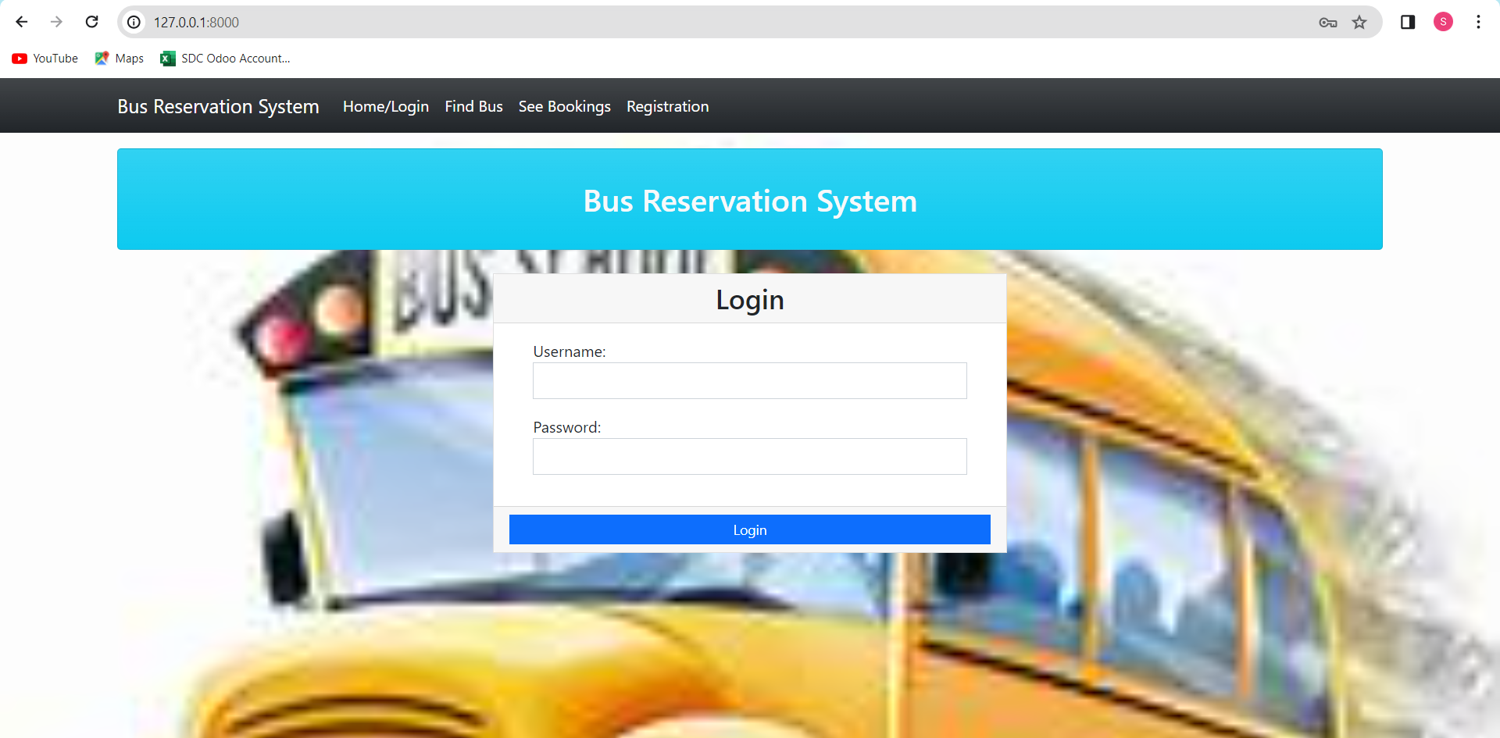

Slide 3
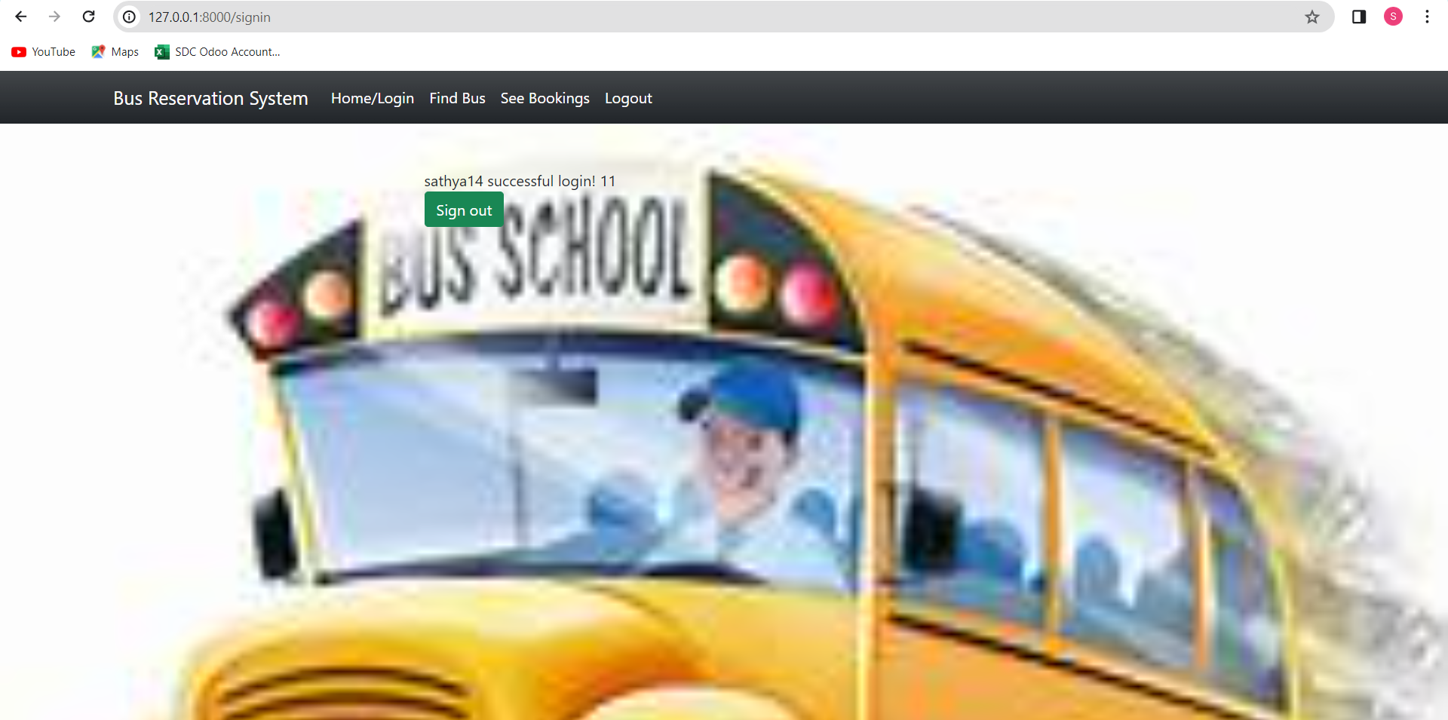
Screenshots

Slide 4
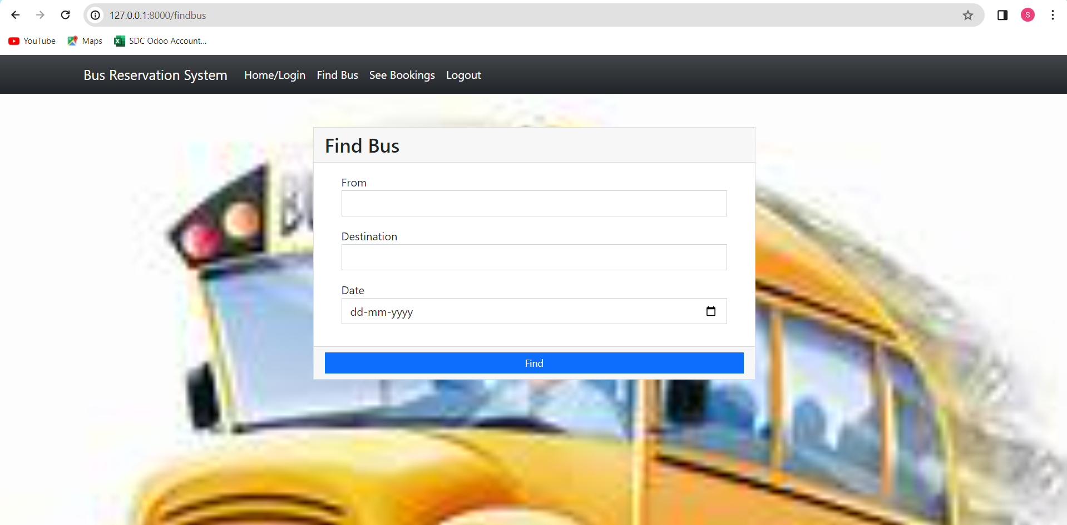

Slide 5
